Slide 1

Ray
Scaling Python made simple

Slide 2





whoami : @theleokul
Data Science MSc 2nd year at Skoltech
CV Engineer at Gradient
Cofounder of Algorithm

Slide 3
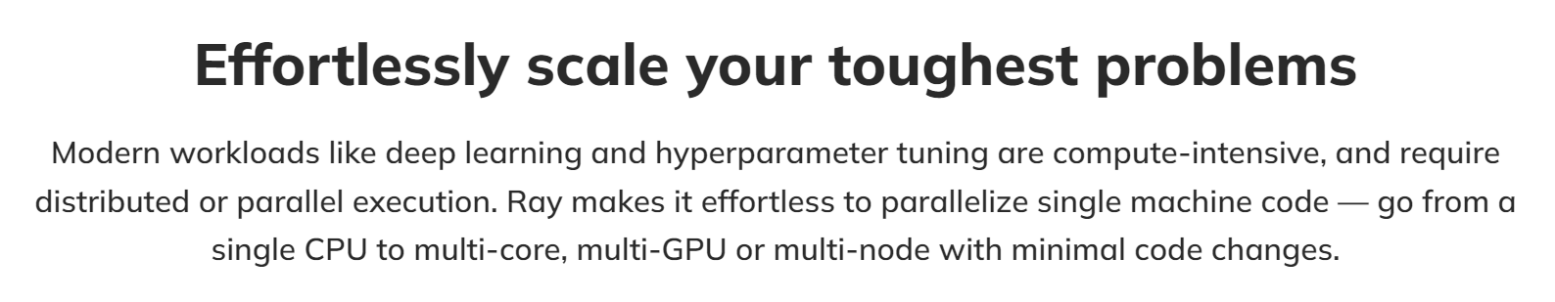
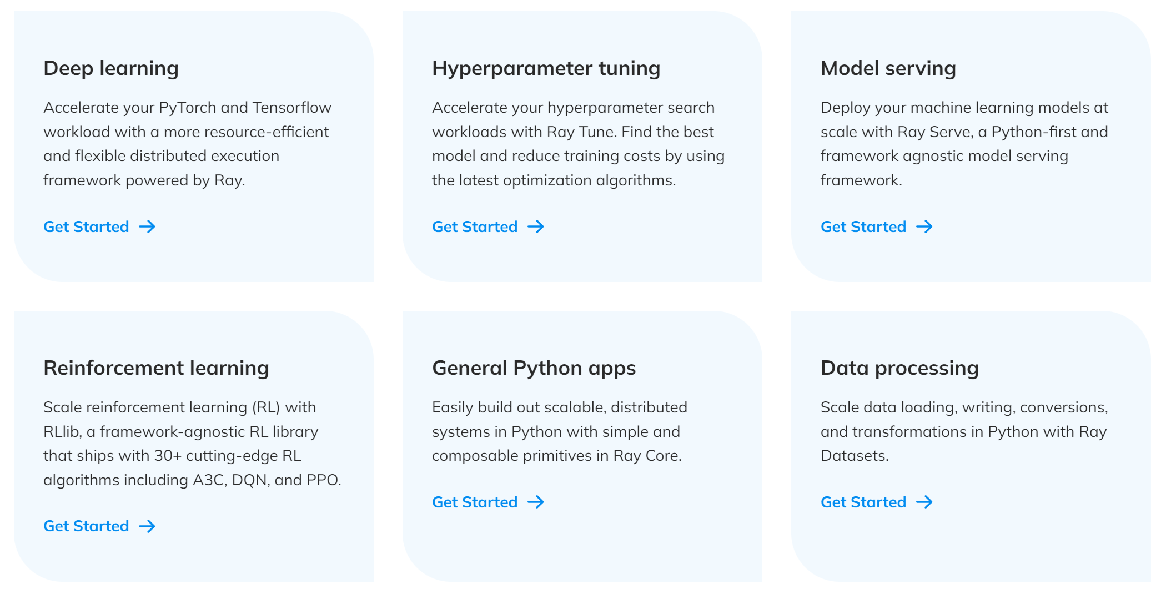
Promo

Slide 4
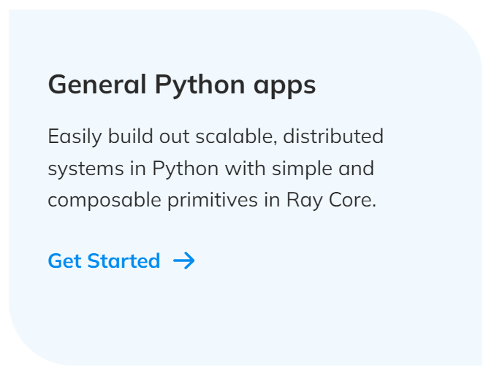
Ray Core

Slide 5
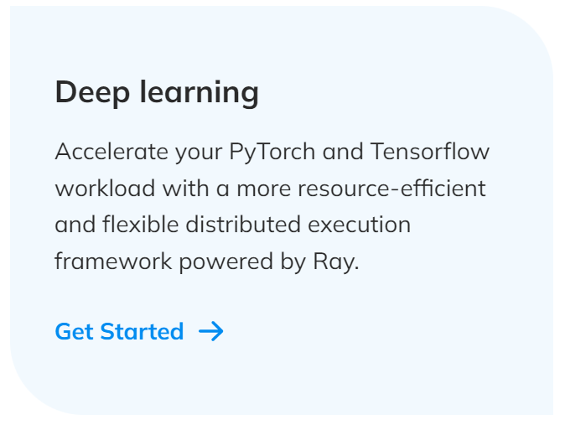
Ray Train

Slide 6
Thank you for your attention and have a good day!

